Slide 1
Psychology’s Scientific Method
King, Chapter 2

Slide 2

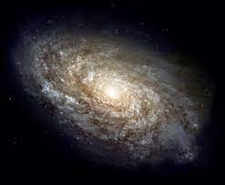
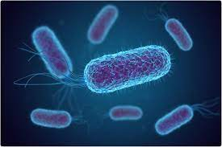
The Scientific Approach (1)
Science is a method, not a topic
Emphasis on HOW something is studied, not what is studied

Slide 3
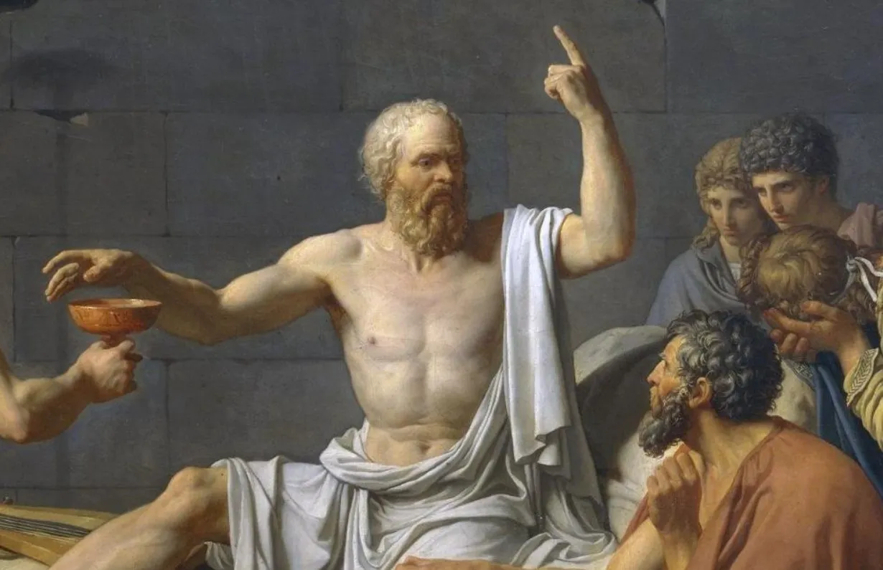
The Scientific Approach (2)
All scientists use the empirical method
  Empirical Method == Using observation or experiments to reach a conclusion.
  Opposite of speculative or exclusively reason-based approaches (like philosophy)

Slide 4
The Scientific Approach (3)
Psychology is a science. That means psychology is empirical!
The 3 goals of Psychology as a discipline include:
  1. Measurement and description
  2. Understanding and prediction
  3. Application and control

Slide 5


What is research?
The investigation and study of materials and sources
Why? Establish facts, reach new conclusions

Slide 6
Two Types of Research (1)
Basic: Research that answers fundamental questions about phenomena

Slide 7
Two Types of Research (2)
Basic: Research that answers fundamental questions about phenomena
Applied: Research that investigates issues that have direct implications for a specific problem

Slide 8
Two Types of Research (3)
BASIC or APPLIED?
  A study into the different kinds of motivation?
    Basic! Why?
  Developing a program to improve children’s reading scores?
    Applied! Why?
  Researching different types of memory strategies?
    Basic (but maybe both?)

Slide 9
The Scientific Method – 5 General Steps
Observe
Hypothesize
Test
Conclusions
Evaluate

Slide 10
The Scientific Method (1)
Observe
Hypothesize
Test
Conclusions
Evaluate
Step 1
Observe some phenomenon
  Get ideas (Curiosity)
  Discover variables
    Manipulated (Independent Variable)
    Measured (Dependent Variable)
  Develop theories
    Organized sets of ideas
Notes:
Note: Curiosity is about the researcher’s motivation / attitude. Variables is about partitioning observations into measurable aspects. Theory is about trying to understand why the observed thing happened.

Slide 11
What’s a theory?
A scientific theory is a set of principles or claims intended to offer some description or explanation of a phenomenon
A scientific theory must be falsifiable! (otherwise it cannot be scientific)

Slide 12
Good vs. Bad Theories
A good theory
Aggression is caused by violent media
A bad theory
Aggression is due to the fact that humans are innately evil.
Can be tested!!!
Cannot be tested!!!

Slide 13
Theories (1)
There is an important gap between the variables of our theory and the variables we can directly observe
Variables exist at two levels:
Theoretical/Conceptual: Specified by theory
  Self-esteem, attraction, learning
Measured: Variables in observable form
  We can’t “see” these processes but infer their existence indirectly
Example: Learning as measured by test performance

Slide 14
Theories (2)
For example, let's say your theory leads you to predict that Facebook use decreases happiness.

Slide 15
Theories (3)
For example, let's say your theory leads you to predict that Facebook use decreases happiness.
 | X decreases Y
Theoretical | Facebook Use | Happiness
Measured | ? | ?

Slide 16
Theories (4)
For example, let's say your theory leads you to predict that Facebook use decreases happiness.
 | X decreases Y
Theoretical | Facebook Use | Happiness
Measured | Minutes spent on Facebook daily | ?

Slide 17
Theories (5)
For example, let's say your theory leads you to predict that Facebook use decreases happiness.
 | X decreases Y
Theoretical | Facebook Use | Happiness
Measured | Minutes spent on Facebook daily | Scores on a Happiness Survey

Slide 18
Defining variables
The process of defining conceptual variables into a form that can be measured is operationalization
  Conceptual variable: Physical Attraction
  Operationalization: How closely you sit next to someone
  What else??

Slide 19
The Scientific Method (2)
Observe
Hypothesize
Test
Conclusions
Evaluate
Step 2
Formulate hypotheses/ predictions
  Must be testable
  Derived from theory
Notes:
Note: Untestable predications cannot be investigated. A hypothesis without a theory does not help build a larger picture of the world.

Slide 20
Hypothesis (1)
Theory: Facebook use decreases happiness.
 | X decreases Y
Theoretical | Facebook Use | Happiness
Measured | Minutes spent on Facebook daily | Scores on a Happiness Survey
Hypothesis: ???

Slide 21
Hypothesis (2)
Theory: Facebook use decreases happiness.
 | X decreases Y
Theoretical | Facebook Use | Happiness
Measured | Minutes spent on Facebook daily | Scores on a Happiness Survey
Hypothesis: People who spend more minutes Facebook will have lower happiness scores

Slide 22
The Scientific Method (3)
Observe
Hypothesize
Test
Conclusions
Evaluate
Step 3
Test the hypothesis via research
  Collect some data
  Analyze it (statistics)
Notes:
Discussion Question: To investigate what influences happiness, how would we measure happiness? Survey? Smiles per hour? Parent judgment?
Suggestion: Alert students that we will be covering statistics in just a few moments

Slide 23
The Scientific Method (4)
Observe
Hypothesize
Test
Conclusions
Evaluate
Step 4
Draw conclusions
  Do the data support/refute hypotheses?
  Are the data consistent with or inconsistent with the theory?
Notes:
Critical Thinking Questions: Is our hypothesis supported? How do the results alter our original theory?
Can we trust our conclusions? Can these findings be generalized to other people in other settings doing other activities?
Replicability enhances our confidence.
Note: Topic of replicability is as much a province of the next slide as of this one.

Slide 24
The Scientific Method (5)
Observe
Hypothesize
Test
Conclusions
Evaluate
Step 5
Re-evaluate the theory
  Modify the theory?
  Replicate?
  Peer review and publication
  Meta-analysis – Are the data patterns found consistent in a group of similar experiments?
Notes:
Note: Peer review protects the field from biased and poorly designed research.
Meta-analysis helps detect a convergence of evidence from multiple studies

Slide 25
The Scientific Method Example (1)
THEORY: Social media use is a way of reducing loneliness

Slide 26
The Scientific Method Example (2)
THEORY: Social media use is a way of reducing loneliness
HYPOTHESIS: People will use Facebook more (# minutes use) when they report higher loneliness over the course of a day

Slide 27
The Scientific Method Example (3)
THEORY: Social media use is a way of reducing loneliness
HYPOTHESIS: People will use Facebook more (# minutes use) when they report higher loneliness over the course of a day
Test: Show data that higher loneliness predicts more average Facebook use.

Slide 28
The Scientific Method Example (4)
THEORY: Social media use is a way of reducing loneliness
HYPOTHESIS: People will use Facebook more (# minutes use) when they report higher loneliness over the course of a day
TEST: Show data that higher loneliness predicts more average Facebook use.
Is our theory correct?
  Maybe? Requires further investigation with more samples, other operationalizations, etc.

Slide 29
Types of Research
Psychologists use three types of research designs
  Descriptive
  Correlational
  Experimental

Slide 30
Descriptive Research
Type of research used to describe a behavioral phenomenon
Types:
  Observation – Observe naturally occurring behaviors (naturalistic observation)
  Surveys/Interviews –Standard set of questions that everyone receives, typically self-report
  Case Studies/Case Histories – Research one or two individuals in depth

Slide 31
Descriptive Research
Type of research used to describe a behavioral phenomenon
Key feature of Descriptive Research: No variable is manipulated (no independent variable)
  Cannot answer why, can only document frequencies in which behaviors occur

Slide 32
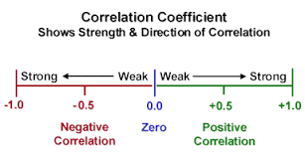
Correlational Research
Correlations demonstrate the relationship between two variables
  Magnitude of the relationship
  Direction of the relationship
Pearson’s r (-1 to +1)
  Number indicates the magnitude (.75 is a stronger relationship than .25)
  Sign indicates the direction

Slide 33
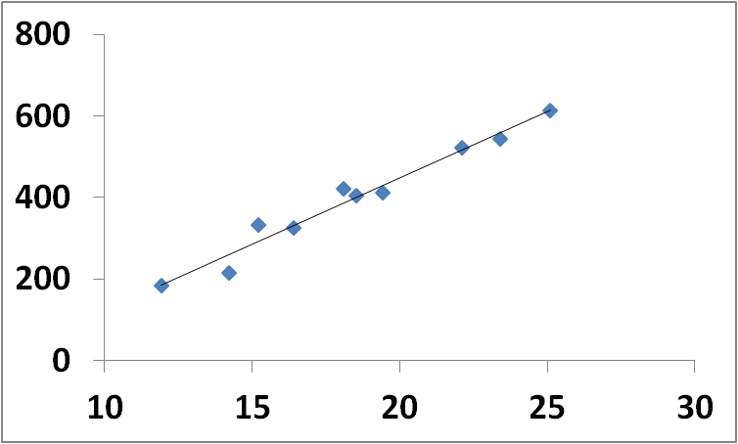
Positive Correlation
Temperature Celsius | Ice Cream Sales ($)
14.2 | 215
16.4 | 325
11.9 | 185
15.2 | 332
18.5 | 406
22.1 | 522
19.4 | 412
25.1 | 614
23.4 | 544
18.1 | 421
r = .984

Slide 34
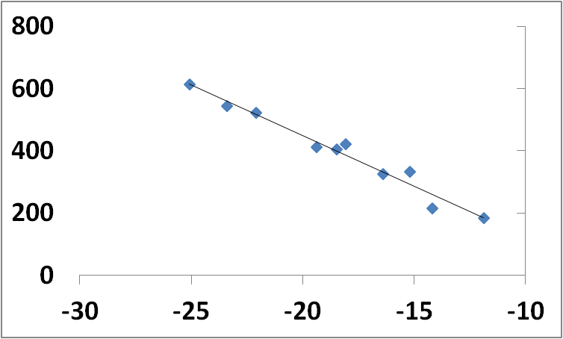
Negative Correlation
Temperature Celsius | Ice Cream Sales ($)
-14.2 | 215
-16.4 | 325
-11.9 | 185
-15.2 | 332
-18.5 | 406
-22.1 | 522
-19.4 | 412
-25.1 | 614
-23.4 | 544
-18.1 | 421
r = -.984

Slide 35
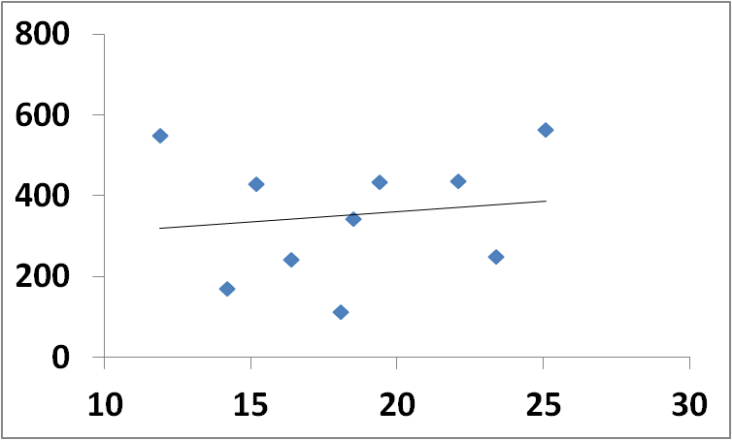
No Correlation
Temperature Celsius | Ice Cream Sales ($)
14.2 | 169
16.4 | 242
11.9 | 550
15.2 | 429
18.5 | 342
22.1 | 435
19.4 | 433
25.1 | 563
23.4 | 250
18.1 | 113
r = .139, ns

Slide 36
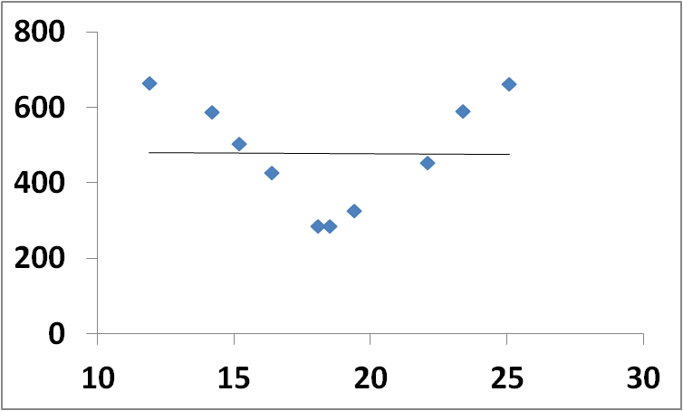
Correlation?
Temperature Celsius | Ice Cream Sales ($)
14.2 | 587
16.4 | 427
11.9 | 663
15.2 | 503
18.5 | 284
22.1 | 454
19.4 | 327
25.1 | 661
23.4 | 589
18.1 | 286
r = -.011, ns

Slide 37
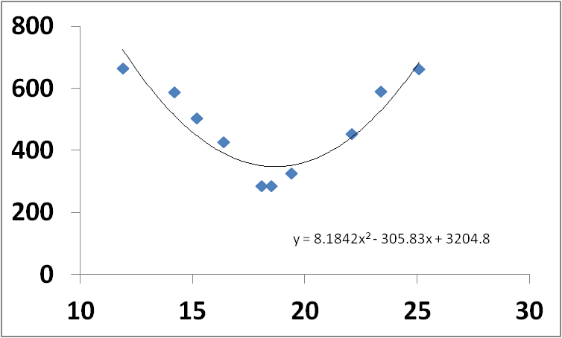
Correlation?
Temperature Celsius | Ice Cream Sales ($)
14.2 | 587
16.4 | 427
11.9 | 663
15.2 | 503
18.5 | 284
22.1 | 454
19.4 | 327
25.1 | 661
23.4 | 589
18.1 | 286
Curvilinear relationship

Slide 38
Correlation ≠ Causation
1.) No variable is manipulated
  There is no experimental context
  There is no random assignment to conditions
  No knowledge of the “range of the scale”
    E.g., how high or low can ice cream sales go?
2.) “Direction of Causation” Problem
  Cannot tell whether X caused Y, or whether Y caused X
  Chicken-Egg Question
  E.g., the amount of time spent reading is positively correlated with vocabulary test performance

Slide 39
Correlation ≠ Causation
3.) “Third Variable” Problem
  X and Y may simply share a common cause, a third variable (Z)
  Thus, the correlation would be “spurious”
    Correlations can at times appear random or have no explanation for their occurrence

Slide 40
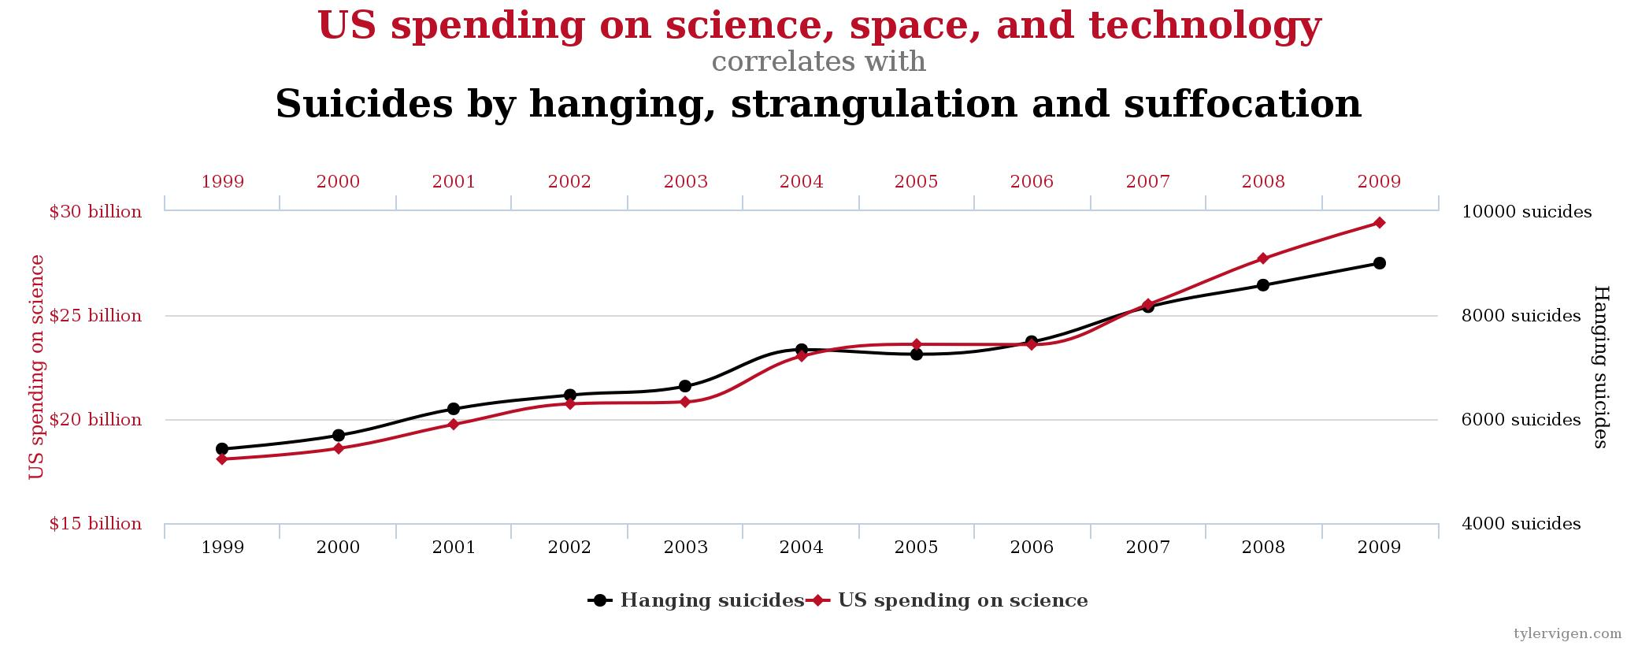
Spurious Correlations
r = .998

Slide 41
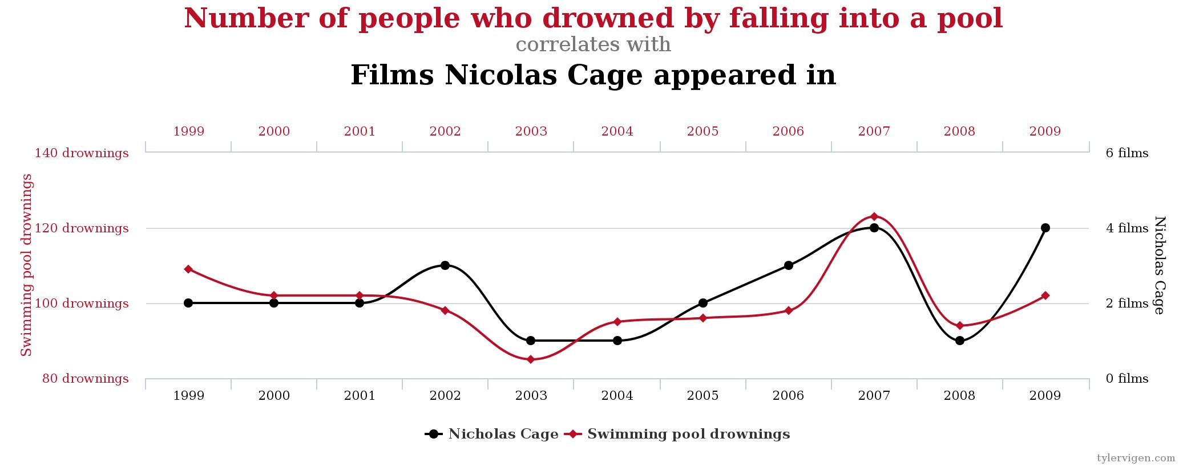
Spurious Correlations
r = .666

Slide 42
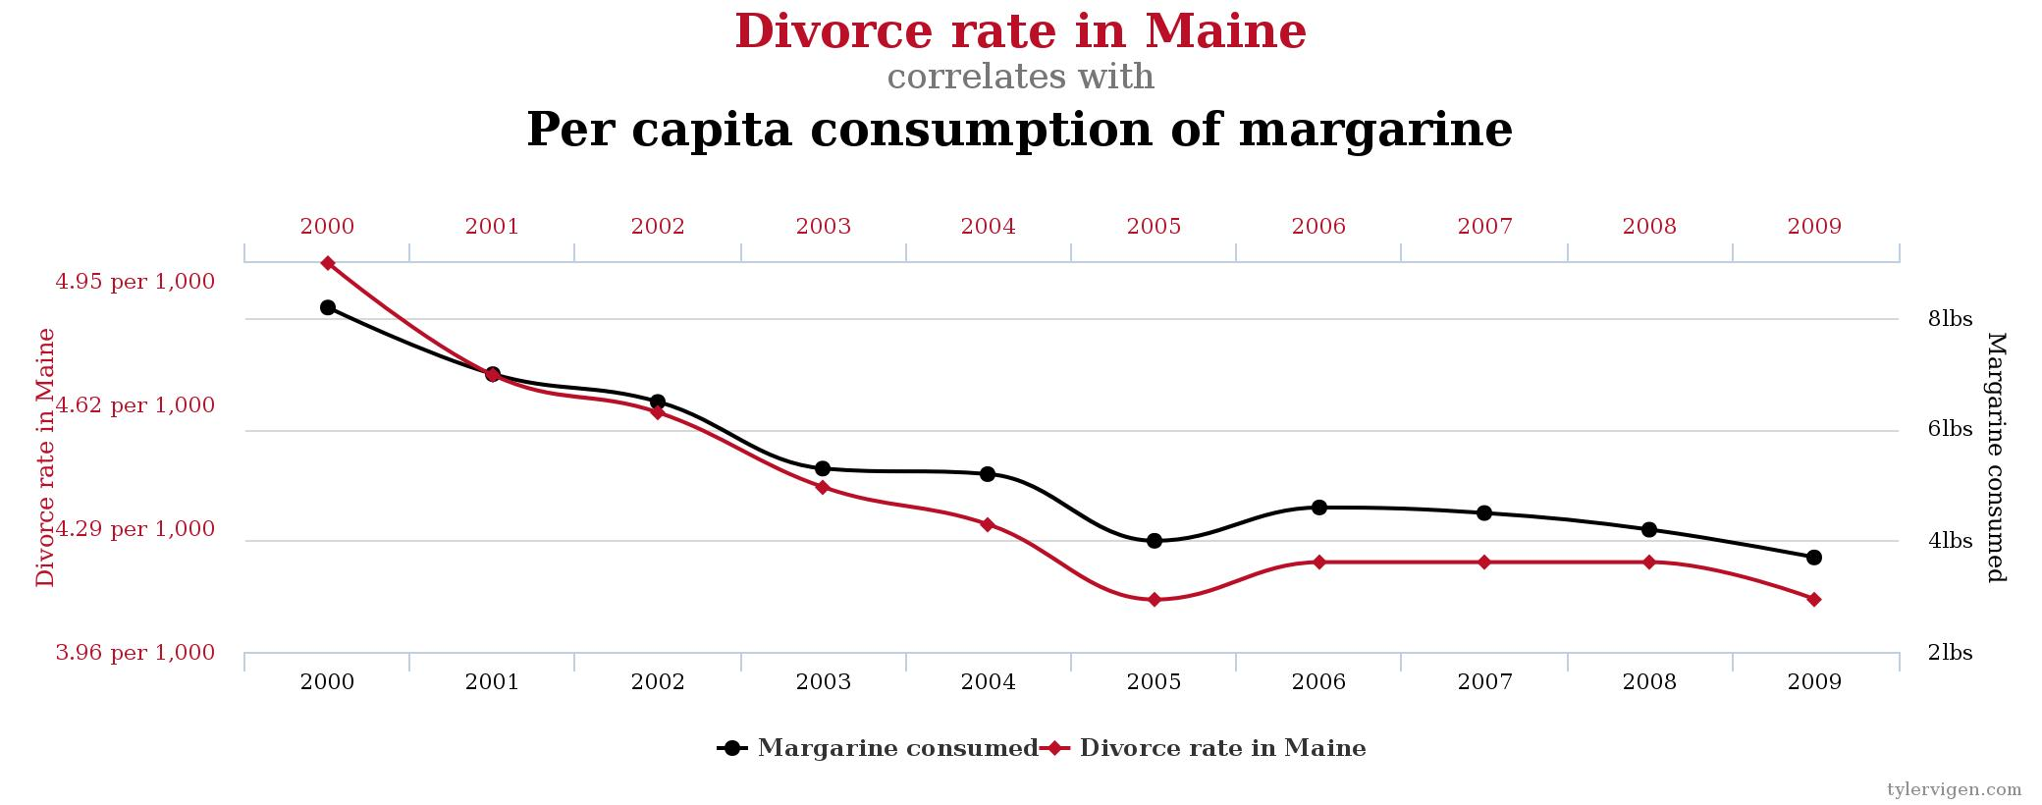
Spurious Correlations
r = .993

Slide 43
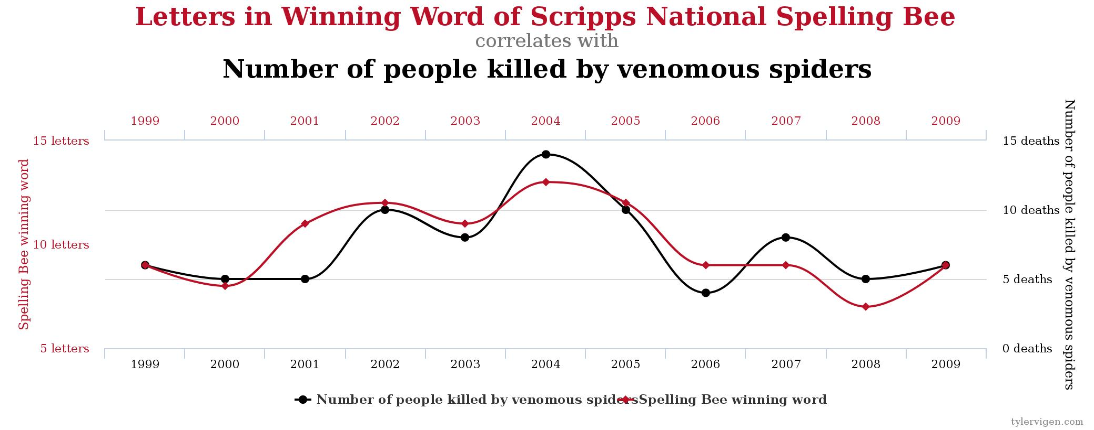
Spurious Correlations
r = .806

Slide 44
Correlations are not ideal… BUT
They allow for predicting a future outcome
  Can ACT/SAT scores predict college success?
  Can number of previous car accidents predict a future accident?
Allow for behavioral measurement where it might not be ethical to manipulate a variable
  Is obesity related to colon cancer? You cannot assign people to being obese vs. non-obese
  I having cancer related to heart disease? Again, cannot ethically give people cancer to document the outcome
Can determine whether there is a relationship between two variables and whether they are worth researching further

Slide 45
Experimental Designs
Experiments involve carefully controlled procedures in which one or more variables are manipulated
  Can infer causation/can explain WHY one variable affects another!!!
Simplest experiment contains 2 groups:
  Group that receives the treatment (e.g., experimental drug)
  Group that receives a placebo (e.g., control group)

Slide 46
Experimental Control
Control over the Independent Variable (IV)
  Ability to “provide” the IV by directly manipulating its occurrence to produce a comparison
A Control Group
  Withhold experimental treatment from a group to serve as a baseline comparison
Does the treatment work?
  Need to compare treatment group to control group!

Slide 47
Experimental Control
Control over Extraneous Variables
  Hold extraneous variables constant across two groups so that they do not become confounds
  Confound = Variable that also changes across experimental groups that could possibly cause outcome differences
Example: A study weight-gain only looks at young adults (older adults are more likely to gain weight)

Slide 48
Confounding Variables (1)
Confounding Variable
Affects the relationship between the two variables
Independent Variable
Dependent Variable

Slide 49
Confounding Variables (2)
Confound?
Less Exercise
Greater Heart Disease Risk

Slide 50
Confounding Variables (3)
Age
Less Exercise
Greater Heart Disease Risk

Slide 51
Spurious Correlations
r = .666

Slide 52
Experimental Design (Review 1)
Experiments involve carefully controlled procedures in which one or more variables are manipulated
  Can infer causation/can explain WHY one variable affects another!!!
Simplest experiment contains 2 groups:
  Group that receives the treatment (e.g., experimental drug)
  Group that receives a placebo (e.g., control group)

Slide 53
Experimental Design (Review 2)
Experiments contain two variable types: Independent Variable (IV) & Dependent Variable (DV)
Big Question: How does changing the IV influence the DV?
Example: Does sleep affect test scores?
  IV == Sleep time, DV == test scores

Slide 54
Independent Variables
Independent Variables (IVs)
  Any condition that changes between two or more experimental groups
    Drug vs. Placebo
    Younger vs. Older Adult
    Hot room temperature vs. normal room temperature
The independent variable is what the researcher manipulates or changes!

Slide 55
Dependent variables
Dependent Variables (DVs)
  Outcome variable
    Performance on a memory test
    Cancer remission
    Aggressive behaviors
The dependent variable is what’s being measured!

Slide 56
Question (1)
Participants in an experimental research study listen to a lecture either in a lecture hall filled with natural light or in a lecture hall with artificial light and no windows. Before leaving the lecture halls, the participants fill out a mood survey.
What is the independent variable?
What is the dependent variable?

Slide 57
Question (2)
Professor Stenson is examining the effects of color on patients' anxiety levels. She randomly assigns patients to either a room painted white or a room painted black; she then records their blood pressure.
What is the independent variable?
What is the dependent variable?

Slide 58
Question (3)
Dr. Kingston, a psychologist, is examining how a student's reading speed is affected by two variables: being tutored by a teacher vs. being tutored by a computer-based program.
What is the independent variable?
What is the dependent variable?

Slide 59
Other types of Measures: Self-Report
Researchers have individuals answer questions about a topic of interest
  Example: measuring self-esteem using a questionnaire
  Note: When researchers ask participants verbally, the self-report is referred to as an interview
Self-reports are useful because they provide direct information about a topic

Slide 60
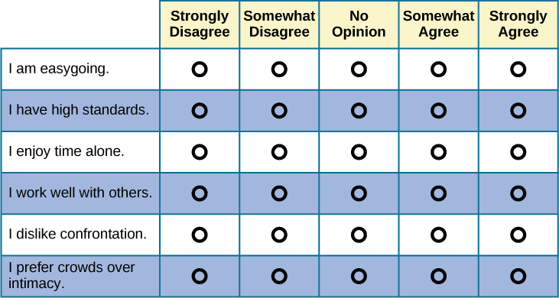
Problems with self-report???

Slide 61
Quasi-Experimental Variables
Not all variables can technically be manipulated
Gender/Sex/Race/Income/Health/Age: Cannot be directly manipulated and are therefore quasi-experimental variables
AGE is a particularly special quasi-experimental variable

Slide 62
Cross-Sectional Studies
Observe or test groups of different ages at the same time
  Downside: Cohort effects
    Differences may result from each groups unique environmental events

Slide 63
Longitudinal Studies
Observe or test one group of individuals at each of several time periods
  Problem: Expensive and a large time commitments!
  No cohort effects, because the same people are tested across time

Slide 64
Potential Dependent Variable Problems
DVs must be sensitive to changes in the IV
Floor Effect
  When most scores (or ratings, etc.) fall at the lower or lowest level of the measurement scale
  When everyone performs poorly, there is no “room” for worse performance
Ceiling Effect
  When most scores (or ratings, etc.) fall at the higher or highest level of the measurement scale
  When everyone performs well, then there is no “room” for better performance

Slide 65
Variables in Experimentation
Control Variables
Extraneous variables that are held constant across all levels of the IV
  Makes them “non-variables”
How do we know which variables to control?
  What variables could affect performance?
  What has past research tried to control for?
  What has past research failed to control for?

Slide 66
Variables in Experimentation
Controlling for variables between groups
Matching
  Ensuring that each group is equivalent on some variable
    Age
    Gender
    Ethnicity
    Intelligence
Can be very challenging to control for everything!!!
Random Assignment = “The great equalizer”
  Individuals are randomly assigned to the groups, any differences in subjects (i.e., age, gender, etc.) have an equal chance of being in the experimental group(s) or the control group

Slide 67
Reliability
Reliability: Does this method consistently measure what is being studied?
  Research is only as good as the measurement used
    Garbage in, garbage out…
  Example: Two rulers should also measure an inch the same way
  Psych Example: A reliable IQ test should show“identical” scores when given twice over a two-week interval

Slide 68
Validity
Validity: Does this accurately measure the variable of interest?
  Example: Does a personality test truly measure extraversion? Or something related like Assertiveness?

Slide 69
Types of Validity
External Validity
  How well do the experimental conditions capture the real world?
  Example: If we are trying to research memory, does the memory task mimic memory use in the real world?
Internal Validity
  Is any change in the DV due to only to the change in the IV?
  Eliminate/Reduce confounds
Experiments strive to attain high external and internal validity

Slide 70
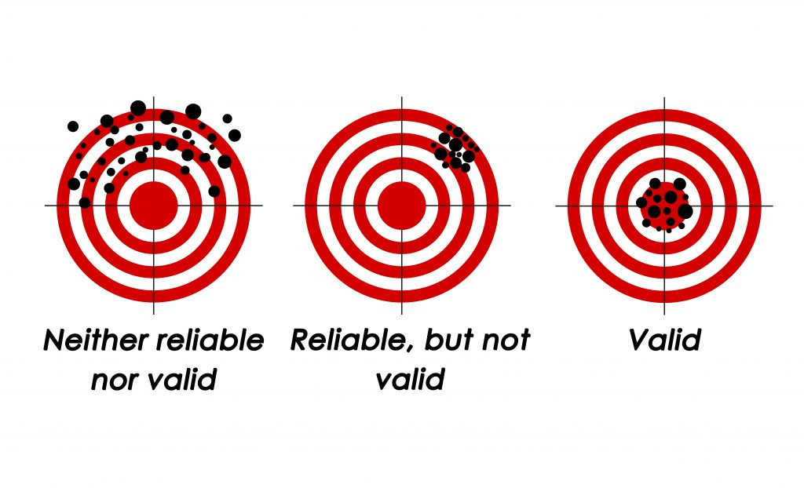

Slide 71
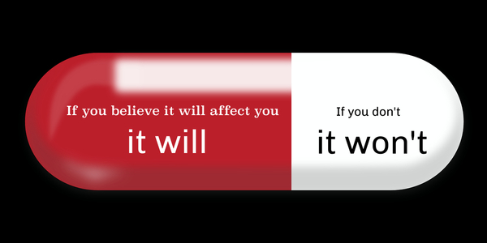
Research Participant Bias
Participants may behave “unnaturally” in an experiment
  Try to “affirm” a known hypothesis
  Act in a way to “sabotage” the experiment…
Placebo Effect
Reducing participant bias
  Blind experiment – Participant does not know the hypothesis
  Deception – Mislead participant about experimental purpose

Slide 72
Experimenter Bias
Expectations can affect the experimental outcome
Demand Characteristics
  Pressure on subjects to behave in a specific way to influence the outcome
Reducing experimenter bias
  Double-blind experiment – both experimenter and participant does not know hypothesis
  Script – set of standard procedures that all experimenters follow

Slide 73

Research Sampling (1)
Population – entire group the researcher wants to sample from
  Need not be everyone on the planet
  USM students → USM women→ USM women in athletics
Sample – subset of the population
Why do we need samples?

Slide 74
Research Sampling (2)
Bias can affect sampling!
Reduce by:
  Random Sampling
  Representative Sampling – every person in the population has an equal chance of being selected for the sample
  Important! The sample must reflect the characteristics of the population of interest

Slide 75
Data Analysis
Have to describe the data collected:
  Descriptive Statistics (Measures of Central Tendency)
  Inferential Statistics

Slide 76
Measures of Central Tendency (1)
Central tendency
  A statistical measure that identifies a single score to define the center of a distribution
Purpose: find the single score that is most typical or best represents the entire group
Notes:
The whole point of this is to find some value that best represents the group.

Slide 77
Measures of Central Tendency (2)
In everyday language:
  What is the “average” or “most typical” response
  This value can be used to provide a simple description of an entire population or sample
  Three Types:
    The Mean (Average) (Sum of all values/ total number of observations)
    Median (Middle Number)
    Mode (Most repeated Number)

Slide 78
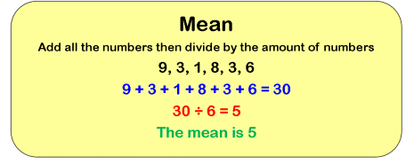
Mean Example

Slide 79
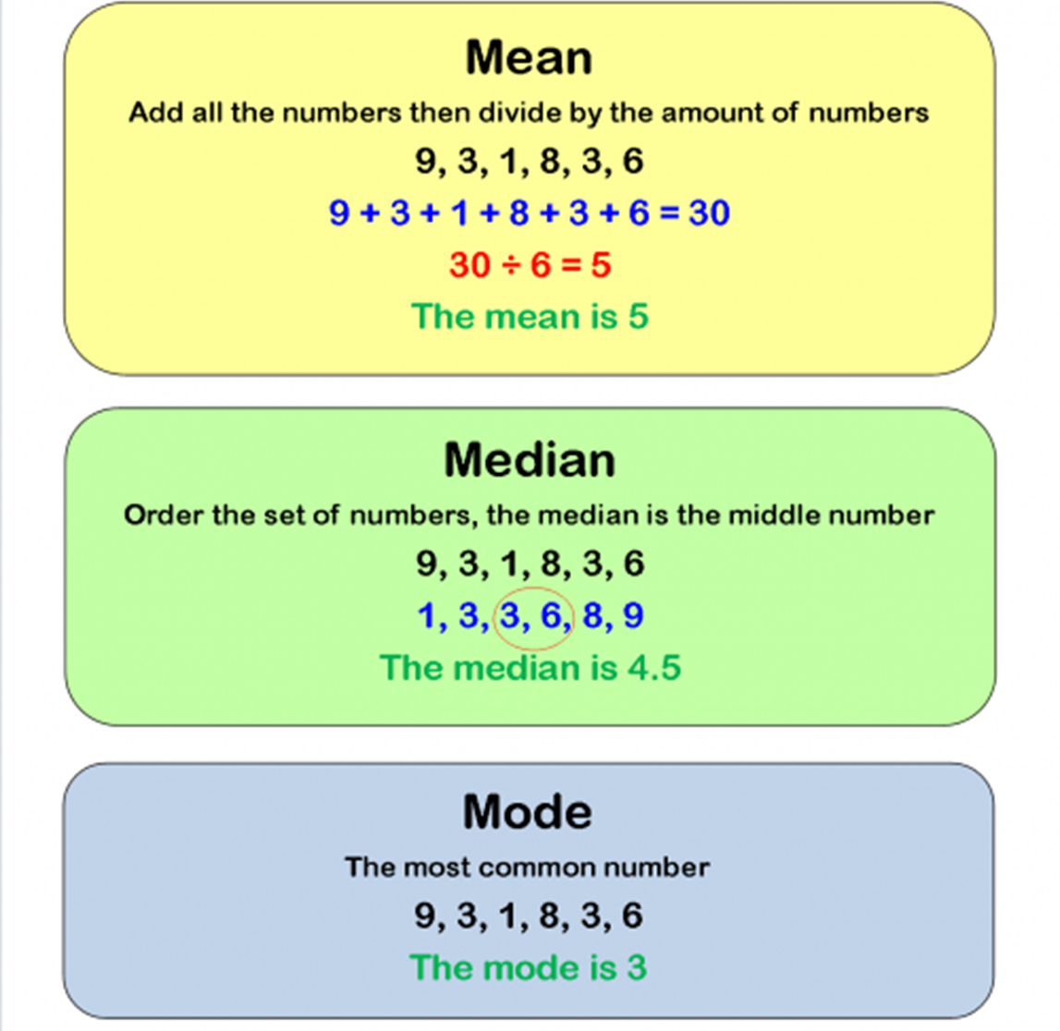
Median and Mode Example

Slide 80
Research Ethics in Psychology
Research is designed with the goal of protecting participants
  No harm, psychological or physical
  Human or animal
Psychologists are bound by the same broad ethical principles as physicians and other clinicians
Psychological Research is governed by Institutional Review Boards (IRBs)

Slide 81
Research Ethics in Psychology
Guidelines:
Informed Consent
Confidentiality
Debriefing
Deception
  OK, provided participants are debriefed about the nature and purpose of the deception after the experiment is completed

Slide 82
Other Ethical Considerations
Harm must be prevented: Participants cannot experience any serious or lasting harm
Privacy: Data must be anonymous and/or protected

Slide 83
Why do we have these safeguards?
Early psychology has a questionable history…
  Remember Watson and Little Albert?
  Other Examples….

Slide 84


Slide 85


Slide 86
Some Questions on Ethics
Does being a participant in a scientific study distort real-life behavior? Do you think people behave differently in an experimental setting vs. everyday life?
What if the only way to collect valid information requires putting participants at risk?
What about deception, such as not informing participants about the true nature of a study?

Slide 87
Be a Good Consumer of Psychological Science! (1)
Avoid overgeneralizations
Group findings do not always mean “individual” findings
  Measures of central tendency do not account for everyone
  Individual differences! Outliers!

Slide 88
Be a Good Consumer of Psychological Science! (2)
Consult multiple studies
  More replications == More evidence!
Be cautious of causal attributions
  Has a cause been found (i.e., shown with an experiment?)? If so, has cause been replicated?
Consider the source
  Who funded the study? Ulterior motive?

Slide 89
IMPORTANT REMINDERS!
Quiz 3 (DUE TONIGHT @ 11:59)
EXAM 1 (IN-CLASS TUESDAY – 9/13)
  BRING A SCANTRON (bookstore!)
Tonight: Mental Health Q&A (5:30-6:30)
  Where? Dillard Room 101
  What? Ask a panel of psychologists questions about maintaining mental health during the semester

